Slide 1
Chapter 3
Capturing and Editing Digital Images
Capturing Images by Digital Photography

Slide 2
In this lecture, you will find answers to these questions
What does megapixel mean?
Does a digital camera with more megapixels always mean better image quality?
Does a digital camera with a higher megapixel rating give bigger prints?

Slide 3
Digital Cameras
point-and-shoot
D-SLR (digital single-lens reflex)
  Most D-SLR cameras use interchangeable-lenses

Slide 4
Digital Camera Sensors
Types
  CCD (charge coupled device)
  CMOS (complementary metal-oxide semiconductor)
The size of the sensor and the number of light-sensing sites determine the maximum resolution of the digital camera.

Slide 5
Megapixels
1 megapixel = 1,000,000 pixels

Slide 6
Megapixels Example
An image of 3000 × 2000 pixels has a total number of pixels of:
3000 × 2000 pixels = 6,000,000 pixels
= 6,000,000 pixels/1,000,000 pixels/megapixel
= 6 megapixels

Slide 7
Megapixels Example
An image of 1600 × 1200 pixels has a total number of pixels of:
1600 × 1200 pixels = 1,920,000 pixels
= 1,920,000 pixels/1,000,000 pixels/megapixel
= 1.92 megapixels
rounded up to 2 megapixels

Slide 8
Megapixels Example
An image of 1800× 1100 pixels has a total number of pixels of:
1800× 1100 pixels = 1,980,000 pixels
= 1,980,000 pixels/1,000,000 pixels/megapixel
= 1.98 megapixels
rounded up to 2 megapixels

Slide 9
Megapixels
Give an approximate number of total pixels in an image
Does not provide information about the aspect ratio (i.e., relative width and height) of the image

Slide 10
Does a digital camera with more megapixels mean better image quality?
No
Digital photo quality is determined by:
  the optics of the lens
  the size and quality of the sensor
  the camera electronics
  the camera’s image processing software

Slide 11
Does a digital camera with a higher megapixel rating give bigger prints?
The print size depends on the printing resolution.
Let's return to our megapixel examples:
  6-megapixel image: 3000 × 2000 pixels
  2-megapixel image: 1600 × 1200 pixels

Slide 12
Print Sizes of a 6-megapixel Image
Printed at 150 ppi:
3000 pixels / 150 ppi = 20"
2000 pixels / 150 ppi = 13.3"
Printed at 300 ppi:
3000 pixels / 300 ppi = 10"
2000 pixels / 300 ppi = 6.7"
Printed at 600 ppi:
3000 pixels / 600 ppi = 5"
2000 pixels / 600 ppi = 3.3"

Slide 13
Print Sizes of a 2-megapixel Image
Printed at 150 ppi:
1600 pixels / 150 ppi = 10.7"
1200 pixels / 150 ppi = 8"
Printed at 300 ppi:
1600 pixels / 300 ppi = 5.3"
1200 pixels / 300 ppi = 4"
Printed at 600 ppi:
1600 pixels / 600 ppi = 2.7"
1200 pixels / 600 ppi = 2"

Slide 14
Does a digital camera with a higher megapixel rating give bigger prints?
As you see in the examples:
With the same printing resolution, yes, images with more megapixels give bigger prints.
With different printing resolutions, the 2-megapixel image (printed at 150 ppi) gives a bigger print than the 6-megapixel image (printed at 300 ppi).

Slide 15
Review Questions
Note to instructor:
Depending on your preference, you may want to go over the review questions at the end of this lecture as an instant review or at the beginning of next lecture to refresh students' memory of this lecture.

Slide 16
Review Question
Name two methods you can capture digital images.
Notes:
scanning and digital photography

Slide 17
Review Question
1 megapixel = ___ pixels
Notes:
1,000,000

Slide 18
Review Question
An image of 6000 × 6000 pixels is said to have ___ megapixels.
Notes:
36

Slide 19
Review Question
Does a digital camera with more megapixels always mean better image quality?
Notes:
No

Slide 20
Review Question
What are the factors of digital cameras that determine the image quality?
Notes:
the optics of the lens
the size and quality of the sensor
the camera electronics
the camera’s image processing software

Slide 21
Review Question
Does a digital camera with a higher megapixel rating give bigger prints?
Notes:
No, it depends on the print resolution

Slide 22
"Digital Media Primer" Yue-Ling Wong,
Copyright (c)2013 by Pearson Education, Inc. All rights reserved.

Slide 23
Chapter 3
Capturing and Editing Digital Images
Part 6
Output Images for Print

Slide 24
In this lecture, you will learn:
how to estimate the print size based on the print resolution and the pixel dimensions of the image
how to estimate the print resolution based on the print size and the pixel dimensions of the image
how to estimate the pixel dimensions of the image based on the print size and the print resolution

Slide 25
Print Size of an Image
Both the pixel dimensions of an image and the image resolution (ppi) affect the image’s print size.
Notes:
You can identify the print size if you both know the pixel dimensions and the print resolution of an image
Select one:
True
False

Slide 26
Print Size of an Image
Both the pixel dimensions of an image and the image resolution (ppi) affect the image’s print size.
What this means that you can't determine the print size if you:
only know the pixel dimensions of an image without the print resolution (ppi)
only know the print resolution (ppi) without the pixel dimensions of an image

Slide 27
To better understand the equation, let's look at 3 scenarios and plug in some numbers.

Slide 28
Scenario 1:
Maintaining the Print Dimensions
To make an 8" x 4.5" print
Print Resolution (ppi) | Required Pixel Dimensions
100 ppi | width = 8" × 100 ppi = 800 pixels height = 4.5" × 100 ppi = 450 pixels
200 ppi | width = 8" × 200 ppi = 1600 pixels height = 4.5" × 200 ppi = 900 pixels
300 ppi | width = 8" × 300 ppi = 2400 pixels height = 4.5" × 300 ppi = 1350 pixels
With a fixed print size, you need larger pixel dimensions with a higher print ppi.

Slide 29
Scenario 2:
Maintaining the Pixel Dimensions
For an image of 1600 x 900 pixels
Print Resolution (ppi) | Resulted Print Size
100 ppi | width = 1600 pixels / 100 ppi = 16" height = 900 pixels / 100 ppi = 9"
200 ppi | width = 1600 pixels / 200 ppi = 8" height = 900 pixels / 200 ppi = 4.5"
300 ppi | width = 1600 pixels / 300 ppi = 5.3" height = 900 pixels / 300 ppi = 3"
With fixed pixel dimensions, you get a smaller print with a higher print ppi.

Slide 30
Scenario 3:
Maintaining the Print PPI
Suppose the print resolution is kept at 300 ppi
Print Size | Required Pixel Dimensions
5.3" × 3" | width = 5.3" × 300 ppi = 1600 pixels height = 3" × 300 ppi = 900 pixels
8" × 4.5" | width = 8" × 300 ppi = 2400 pixels height = 4.5" × 300 ppi = 1350 pixels
16" × 9" | width = 16" × 300 ppi = 4800 pixels height = 9" × 300 ppi = 2700 pixels
With a fixed print ppi, you need larger pixel dimensions for a larger print.

Slide 31
So, how are these scenarios translated into the settings used in an image-editing program?

Slide 32
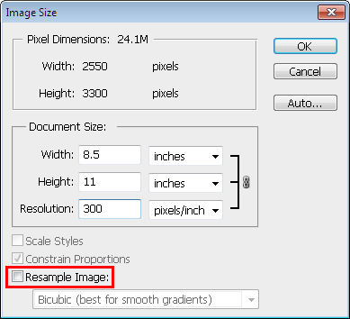
Adjust Output Resolution or Print Size in Photoshop:
Image > Image Size...
Scenario 2: Fixed pixel dimensions
You cannot change the pixel dimensions

Slide 33
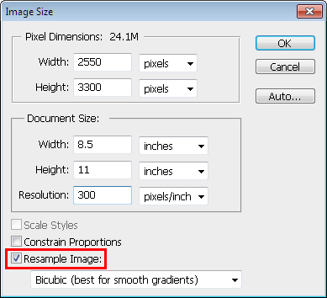
Adjust Output Resolution or Print Size in Photoshop:
Image > Image Size...
Scenario 1: Fixed Print Size
If you change the Resolution, the Pixel Dimensions will be updated automatically while keeping the print size fixed.

Slide 34
Adjust Output Resolution or Print Size in Photoshop:
Image > Image Size...
Scenario 3: Fixed Print Resolution (PPI)
If you change the Pixel Dimensions or Document Size, the other will be updated automatically while keeping the Resolution fixed.

Slide 35
Resample Image
With the Resample Image option on, the pixel dimensions can be varied.
Scaling the pixel dimensions of an image is referred to as resampling because the number of samples (pixels) is changed.

Slide 36
Effect of Resampling Image on Image Quality
Scaling an image usually deteriorates the image quality somewhat.
Scale down: You are removing pixels, i.e., the image will lose some details.
Scale up: Interpolation will be perform to fill in extra pixels. The resulted image will appear blurry.

Slide 37
Print Resolution PPI vs.
Printer Resolution DPI
Print Resolution PPI ≠ Printer Resolution DPI

Slide 38
Printer Resolution DPI
Number of ink dots per inch
Color inkjet printers produce a microscopic spray of ink which appears to be very tiny dots of ink.
These ink dots of different colors--but a limited number of colors--produce the required color by optical mixing.
The color of a single pixel of an image is represented by a group of printer dots.

Slide 39
Print PPI vs. Printer DPI
 | Increasing Print PPI | Increasing Printer DPI
Effect on print size | Depending on the scenario, the print size may decrease or maintain the same. | No
Effect on image quality | No | The color appears smoother on the print. However, higher dpi uses more ink and requires longer time to complete the print job

Slide 40

An interactive demonstration on optical color mixing
Also see the interactive tutorial:
Optical Color Mixing in Pointillism,
Dithering, and Inkjet Printing

Slide 41
Review Questions
Note to instructor:
Depending on your preference, you may want to go over the review questions at the end of this lecture as an instant review or at the beginning of next lecture to refresh students' memory of this lecture.

Slide 42
Review Question
True/False: When a digital image is printed, each image pixel is represented by one printer ink dot.
Notes:
False

Slide 43
Review Question
Resampling an image is often referred to as ______ .
A. rotating
B. scaling
C. translating
D. repositioning
Notes:
B

Slide 44
Review Question
True/False: Resampling an image will have negative impact on the image quality.
Notes:
True

Slide 45
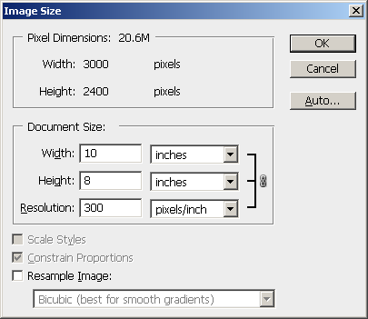
Review Question
The pixel dimensions of the image are ___ × ___.
Notes:
3000 x 2000 pixels

Slide 46
Review Question
The physical size of the image, if it is printed out is ___ × ___.
Notes:
10" x 8"

Slide 47
Review Question
The printing resolution of the image is ___.
Notes:
300 ppi

Slide 48
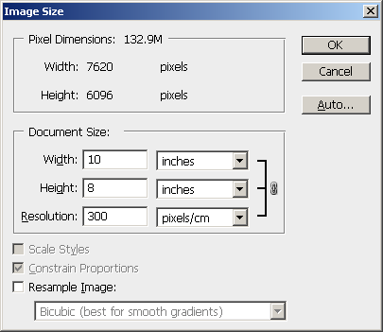
Review Question
The image should have the pixel dimensions 3000 × 2000 pixels. Identify the incorrect setting that causes such a discrepancy in pixel dimensions.
Notes:
The unit in the Resolution is set to pixels/cm; it should be pixels/inch.

Slide 49
Review Question
For the following questions, predict the new values in the Image Size window.

Slide 50
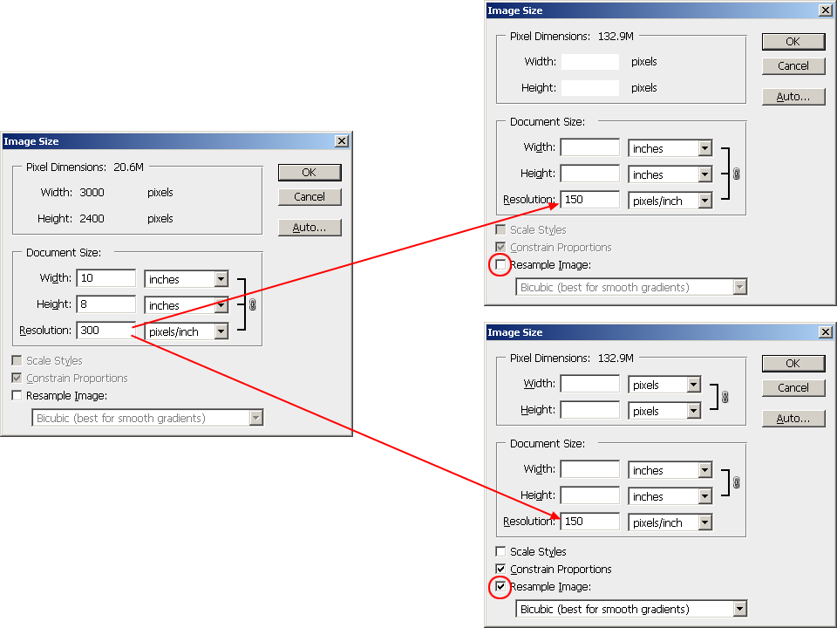

Slide 51
Answers
3000
2400
20
16
1500
1200
10
8

Slide 52
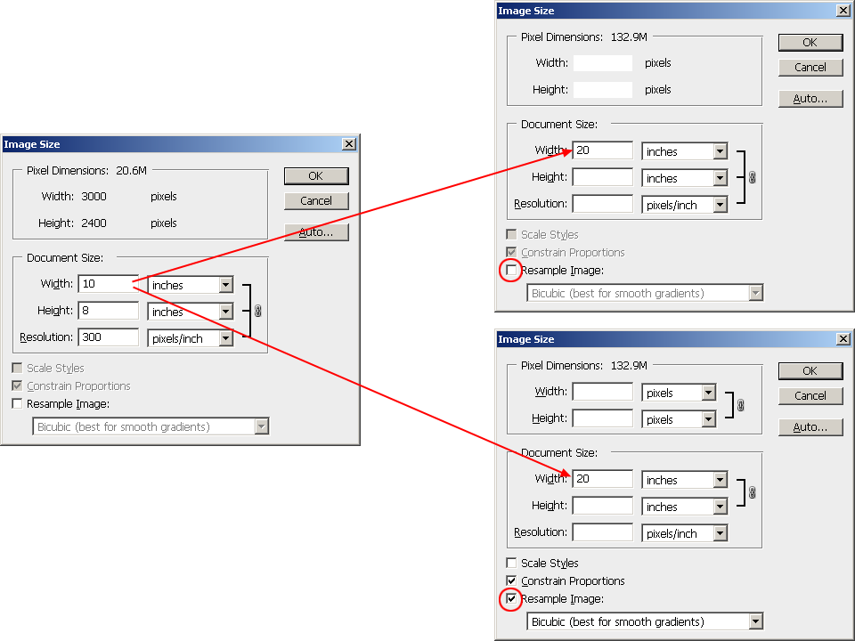

Slide 53
Answers
3000
2400
16
150
6000
2400
16
300

Slide 54
Review Question
Suppose you have created an image (with size information shown in the next slide) and you want to print it on a 10" × 8" paper with at least a half-inch margin all around. Fill in the correct image settings that can accomplish this task with the maximum printed area for the image without affecting the image quality.

Slide 55
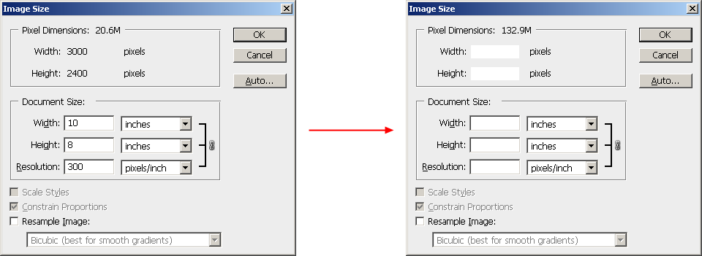

Slide 56
Answers
3000
2400
8.75
7
343
unchecked

Slide 57
"Digital Media Primer" Yue-Ling Wong,
Copyright (c)2013 by Pearson Education, Inc. All rights reserved.

Slide 58
Chapter 3
Capturing and Editing Digital Images
Part 8
Vector Graphics

Slide 59
In this lecture, you will learn:
what make up a vector graphic object
what are paths, anchor points, direction handles, strokes, fills
the common tools to create and edit vector graphics
how to adjust the curviness and tangent of a path

Slide 60
Vector Graphics
Objects and shapes made up with paths, points, strokes and fills
Not pixel based

Slide 61
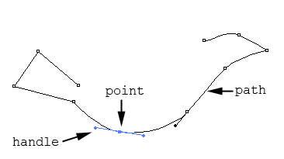
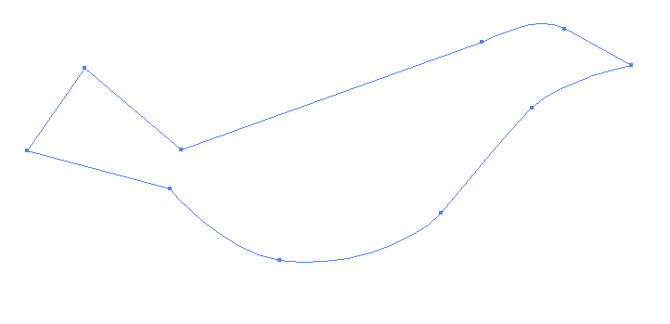
Paths
open path
closed path

Slide 62
Paths and Points
A mathematical description of an abstract line or curve
Defined by a set of points, called anchor points

Slide 63
Tangent and Curviness
Each point has direction handles or tangent handles.
Handle's angle: tangent at the point
Handle's length: curviness at the point

Slide 64
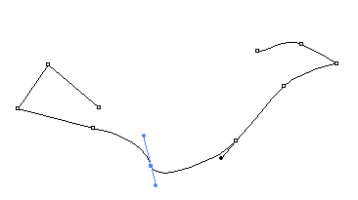
Angle of Handle: Tangent

Slide 65
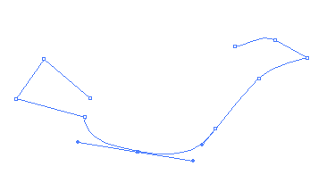
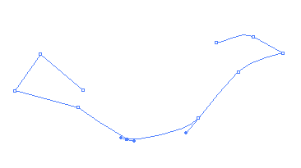
Length of Handle: Curviness
Longer handle
Curvier at the point
Shorter handle
More angular at the point

Slide 66
Corner Points vs. Smooth Points
Corner point:
  appears sharp and angular
  handles have zero length
  used for creating straight segments
  In vector graphic programs, a corner point does not have handles.
Smooth point:
  has direction handles to let you adjust the tangent and curviness at the point

Slide 67
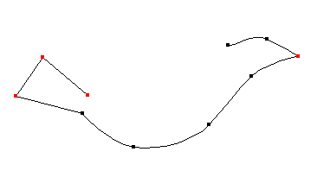
Corner Points vs. Smooth Points
smooth point
corner point
smooth point
corner point
corner point
corner point
smooth point
smooth point
smooth point
smooth point

Slide 68
Common Tools in Adobe Illustrator

Slide 69
Tools to Create Paths
Pen tool:
Simple click: Corner point
Hold the mouse and drag:
Drag out a handle to create a smooth point

Slide 70
Tools to Convert between a Smooth Point and a Corner Point
Convert Anchor Point tool:
Click on a point to convert it into a corner point
Click-drag on a point to drag out a handle, making it a smooth point

Slide 71
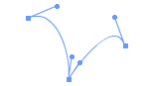
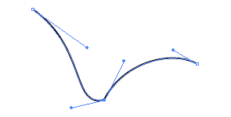
Breaking Dependency of Handles
A handle has two sides
Each side can be adjusted separately
ALT-drag (Windows) or Option-drag (Mac OS) on one of the handles to break their dependency

Slide 72

Practice drawing a simple path by using Pen tool, Convert Anchor Point tool, adjusting handles, and breaking dependency of handles.
Also try out the Activity described in the book:
Drawing Paths with Pen Tool

Slide 73
Strokes
A path does not have a physical appearance--line width or color--until the path is stroked with a specified line style, width, and color

Slide 74
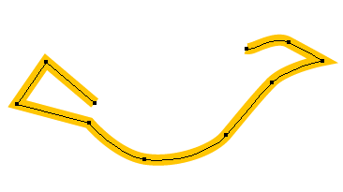
Strokes
A path without stroke.
It will not be printed.
It will not show up during the editing unless you select the path.
A path stroked with orange line

Slide 75
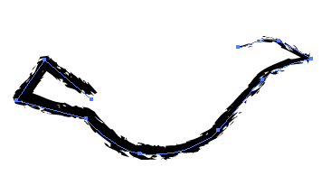
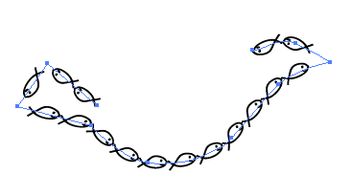
Strokes
The path stroked with a line of charcoal brush style
The path stroked with a line of custom brush style of a small fish

Slide 76
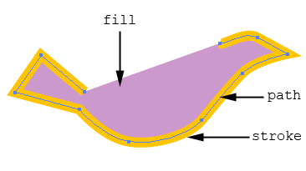
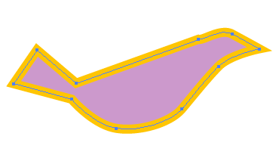
Fill
A color, pattern, or gradient inside a shape defined by a path
Can be applied to open and closed paths

Slide 77
Preset Shapes and Free-Form Drawing
Preset shape drawing tools:
  ellipses
  rectangles
  polygon
  stars
  spirals
Free-Form drawing tool:
  draw a freeform path with a continuous stroke without manually defining the points
  a freeform path is still made up of points

Slide 78
Selection Tools
Selection tool
  select a whole object
Subselection or Direction Selection tool
  select the points and handles

Slide 79
Other Useful Features
Layers
Effects
Filters

Slide 80
Review Questions
Note to instructor:
Depending on your preference, you may want to go over the review questions at the end of this lecture as an instant review or at the beginning of next lecture to refresh students' memory of this lecture.

Slide 81
Review Question
A path does not have physical appearance until ___.
Notes:
it is stroked with a specified line style, width, and color

Slide 82
Review Question
Matching:
path
fill
stroke
(i)
(ii)
(iii)
Notes:
A – (ii)
B – (i)
C – (iii)

Slide 83
Review Question
Fill in the blanks with 2 of these words:
path stroke fill curviness tangent width
color
The handle's length controls the ___ at the point and the handle's angle controls the ___ at the point.
Notes:
curviness
tangent

Slide 84
Review Question
Which of the following apply to corner points?
appear sharp and angular
used for creating straight segments
handles have zero length
have direction handles to let you adjust the tangent and curviness at the point
Notes:
A, B, and C

Slide 85
Review Question
Which of the following apply to smooth points?
appear sharp and angular
used for creating straight segments
handles have zero length
have direction handles to let you adjust the tangent and curviness at the point
Notes:
D

Slide 86
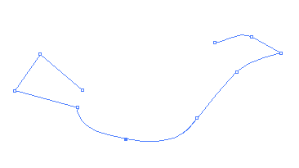
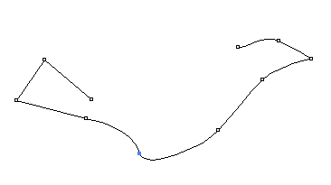
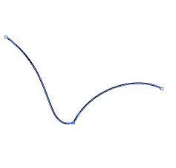
Review Question
Which point's handle dependency is broken?
A
B
C
Notes:
C

Slide 87
Review Question
The Selection tool let you select ___.
the whole object
the points and handles on a path
Notes:
A

Slide 88
Review Question
The Subselection or Direct Selection tool let you select ___.
the whole object
the points and handles on a path
Notes:
B

Slide 89
Review Question
True/False: When you use the free-form drawing tool to draw a path, it is not made up of anchor points any more.
Notes:
False

Slide 90
"Digital Media Primer" Yue-Ling Wong,
Copyright (c)2013 by Pearson Education, Inc. All rights reserved.

Slide 91
Chapter 3
Capturing and Editing Digital Images
Part 7
Output Images for Web

Slide 92
In this lecture, you will learn:
the characteristics, pros, and cons of the common file formats for Web images
how to choose image file format for Web
what dithering means

Slide 93
Common File Formats for Web Images
JPEG
GIF
PNG

Slide 94
JPEG
best with:
  continuous-tone images with a broad color range
  subtle color and brightness variations
  e.g., photographs and images with gradients.
JPEG supports 24-bit color (millions of colors)
JPEG compression: lossy
(it loses image data in order to make the file size smaller)

Slide 95
JPEG
Does not work well with:
  solid colors
  A color solid is the three-dimensional representation of a color model, an analog of the two-dimensional color wheel. The added spatial dimension allows a color solid to depict an added dimension of color variation.
  contrast image
  contrast edges
Highly compressed JPEG images:
  blur the image detail
  show a visible artifact around the high contrast edges

Slide 96
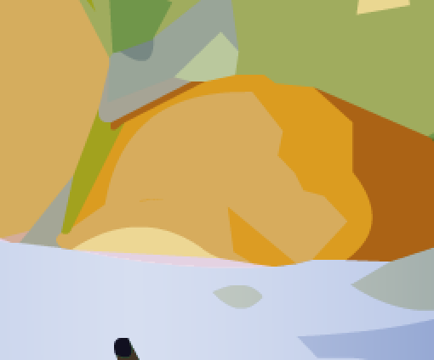

JPEG Compression Artifacts
Original
Highly compressed JPEG
Note the ugly artifacts at the intersection between 2 colors.
The solid colors are not solid colors anymore.

Slide 97
GIF
most effective for images with solid colors such as illustrations, logos, and line art
Up to 8-bit color (256 colors)
supports background transparency
animated GIF

Slide 98
Color Reduction
GIF uses a palette of up to 256 colors to represent the image
Need to reduce the colors if the original image has more than 256 colors
Advantage:
Smaller file size after reducing number of colors (i.e., reducing bit-depth or color-depth)
(Recall that reducing bit-depth or color depth can reduce file size.)

Slide 99
Color Reduction
Determine which colors are in the palette. Options available in Photoshop
Perceptual
Selective
Adaptive
Restrictive
Custom

Slide 100
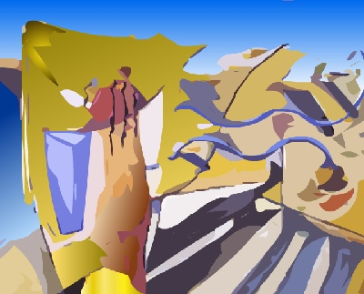
Example: Original TIF
(file size: 406 KB)

Slide 101
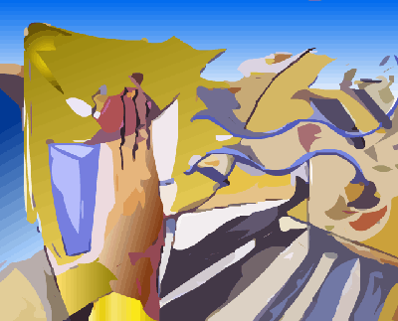
Example: GIF 256 colors, no dither
(file size: 28 KB)

Slide 102
Example: GIF 256 colors, no dithering
(file size: 28 KB)
Note the stripes in the gradient areas.
This is due to not enough colors.

Slide 103
Color Reduction
Undesirable effects
  stripes in smooth gradient areas
  some colors are altered (remapped to a different colors on the palette)
Use dithering to reduce the undesirable effects

Slide 104
Dithering
  A technique to simulate colors that are outside of the palette by using a pattern of like colored pixels.

Slide 105

Example: GIF 256 colors, with dithering
(file size: 34 KB)
The stripes in the gradient areas are less noticeable.

Slide 106
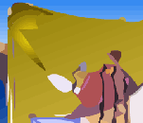

Without and With Dithering
Reduce the stripes effect
Smooth out the color transition

Slide 107
Without and With Dithering
Some colors are not solid anymore, but with dithering

Slide 108
PNG
PNG-8
  up to 256 colors (8-bit)
PNG-24
  24-bit colors
  lossless compression
  larger file size than JPEG but without the ugly JPEG compression artifacts

Slide 109
1. Hands-on to optimize files in JPEG, GIF, and PNG formats and to adjust the compression settings to achieve the balance between the file size and overall image quality.
2. Learn the type of images that each of these file formats is most effective at compressing.
Also try out the worksheet:
Worksheet: JPEG versus GIF versus PNG

Slide 110
Review Questions
Note to instructor:
Depending on your preference, you may want to go over the review questions at the end of this lecture as an instant review or at the beginning of next lecture to refresh students' memory of this lecture.

Slide 111
Review Question
What kind of images are GIF files most appropriate for?
A. big areas of solid colors
B. continuous tone photographs
C. lots of gradients
Notes:
A

Slide 112
Review Question
What kind of images are JPEG files most appropriate for?
A. big areas of solid colors
B. continuous tone photographs
C. lots of gradients
Notes:
B and C

Slide 113
Review Question
Which file format(s) can be created as an animated sequence?
A. JPEG
B. PNG
C. GIF
Notes:
C

Slide 114
Review Question
Which file format(s) can have transparency?
A. JPEG
B. PNG
C. GIF
Notes:
B and C

Slide 115
Review Question
Saving an image with more than 256 colors into a GIF may have the undesirable effects as discussed in the lecture.
So why or when would you want to save an image as a GIF?
Notes:
reduce file size
create an animated gif
background transparency (although PNG can have transparency)

Slide 116
Review Question
In general, a PNG-24 file has a larger file size than a JPEG.
So why or when would you want to save an image as a PNG instead of a JPEG?
Notes:
lossless compression (so you can keep it for further editing)
no ugly JPEG artifacts
an image that has contrast edges and solid colors (which JPEG does not work well with)

